Slide 1
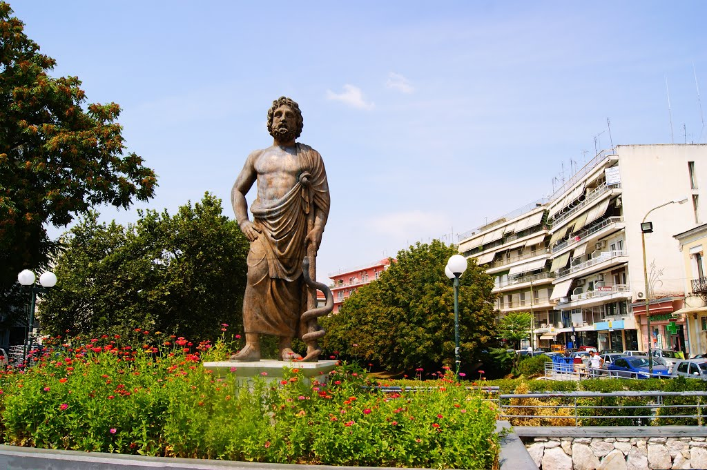
ASKLEPIUS

Slide 2
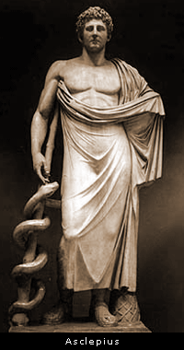
Asclepius was a Hero and theGod of medicine in ancient Greek religion and mythology. He represents the healing aspect of the medical arts.

Slide 3
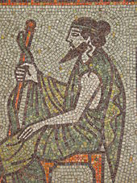
He was associated with the Roman/Etruscan god and the Egyptian Imhotep. He was one of Apollo's sons, sharing with Apollo the epithet Paean "the Healer" .

Slide 4
EDUCATION

Slide 5
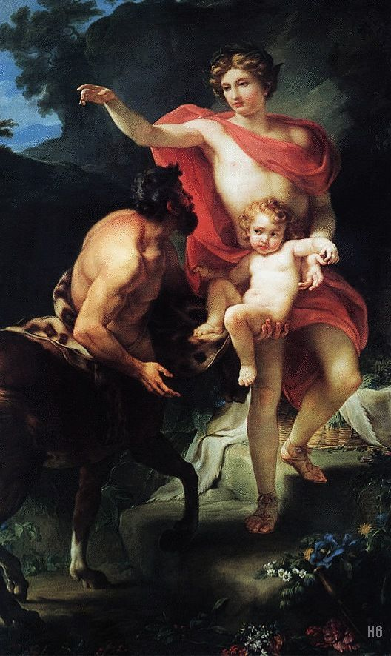
Apollo carried the baby to the centaur Chiron who raised Asclepius and instructed him in the art of medicine.

Slide 6
SΥMBOL

Slide 7
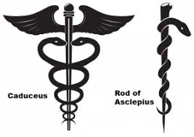
The rod of Asclepius, a snake-entwined staff, remains a symbol of medicine today. (Those physicians and attendants who served this god were known as the Therapeutic of Asclepius.)

Slide 8
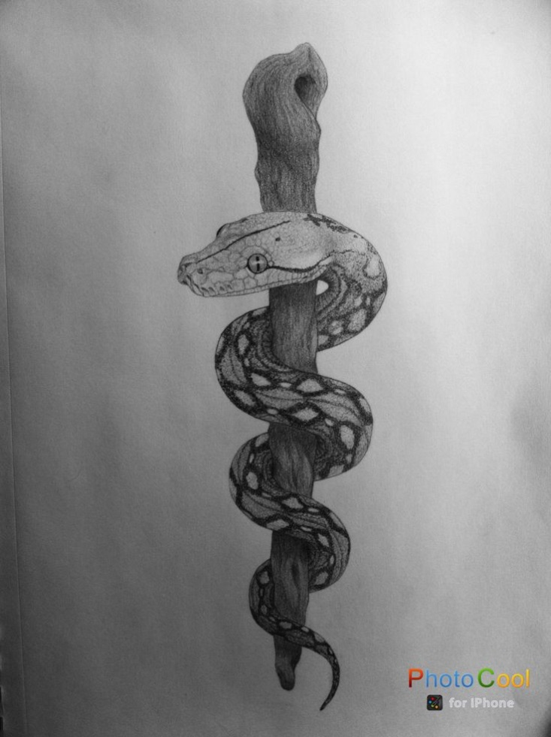
It is said that in return for some kindness rendered by Asclepius, a snake licked Asclepius’ ears clean and taught him secret knowledge. Asclepius bore a rod wreathed with a snake, which became associated with healing.

Slide 9
ASCLEPIUS AND MEDICINE

Slide 10
Asklepius contribution to Medicine has made him been recognized so far, as its founder.

Slide 11
One of the therapies of the Asclepius was the incorporation. The patient came into contact with the god through his dreams and when he awoke he had healed

Slide 12
Asclepius also believed that the water and other natural elements were very beneficial for the human body so they were the main ingredients of his therapies

