Slide 1
Less chemicals more quality life

Slide 2
Modified or mutated products 5th LYCEUM OF TRIKALA-GREECE ( FEBRUARY 2018)

Slide 3
What are modified or mutated organisms?
Mutants or otherwise genetically modified organisms are those products which were created artificially by scientists by removing or adding genes from organisms that may even belong to completely different species.
Example: Scientists can get genes from animals and transfer them to plants or even genes from microbes and add them to corn. So the new organization that will come out of this way will be a modified organization that would never happen naturally.
People have been changing organisms that have been producing food since ancient times by methods such as selective breeding, that is, the selected crossing of organisms of the same species or related species.

Slide 4
What is genetic modification?
Genetic modification of organisms is the isolation of selected genes from an organism (animal, plant, insect or microbe) or from a virus and the technical introduction of these genes into the same or completely different organism in order to create species with new properties. Furthermore, genetic modification can be done not only by the addition but also by the removal or alteration of one or more genes.

Slide 5
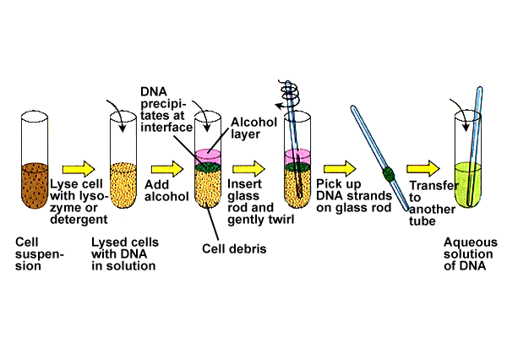
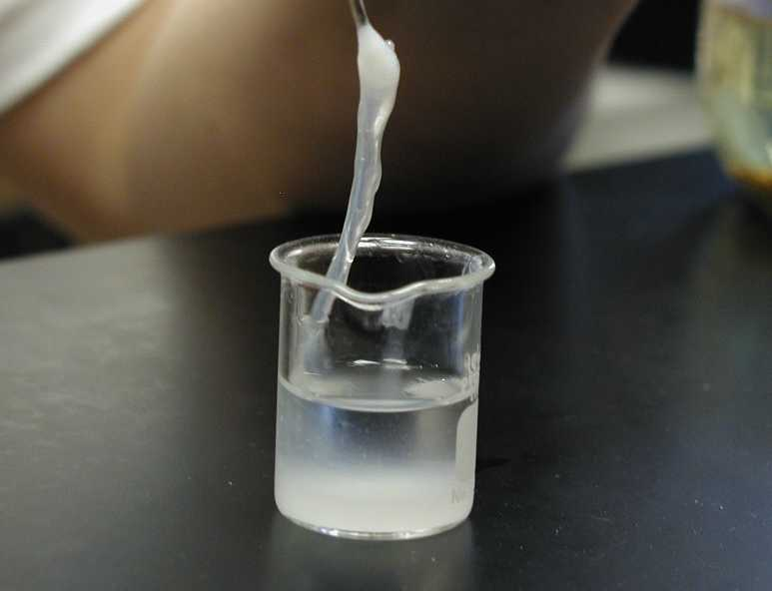
Extraction of genes and transfer to another organism

Slide 6
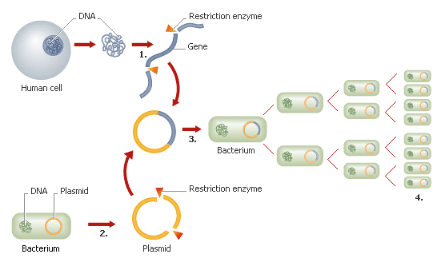
Genetic modification

Slide 7
PLANT SPECIES | CHARACTERISTICS
CORN | INSECT RESISTANCE, RESISTANCE TO HERBICIDES
SOY | RESISTANCE TO HERBICIDES
RAPESEED | RESISTANCE TO HERBICIDES
PUMPKIN | RESISTANCE TO VIRUSES
POTATO | RESISTANCE TO HERBICIDES , INSECT RESISTANCE,

Slide 8
Is genetically modified or mutated food safe for our diet?
The most of the modified products are directed to the human’s and animal’s diet.
The inserting genes can:
split up the natural genes,
be unstable in the new environment or
operate in a different way than expected.
Genetically modified animals
Modification of genetic material to embryo
Cloning ( as an example: sheep Dolly)
Sheep dolly was born in 5 July 1996 and she was cloned through the core transfer process from live adult cells by Ian Wilmut and Keith Campbell and with their colleagues from the Roslin Institute near Edinburgh in Scotland. She was generated from a mammalian gland derived cell. It was the first successful attempt to clone a mammal from an adult cell and as it was natural, it became the first news story in all international media. Though, Dolly was shot dead in 2003 at just 6 years of age to end the pain and discomfort suffered by advanced respiratory disease and arthritis.

Slide 9
What does this mean for food safety?
Genetic engineering is possible to affect food safety in two ways:
the breakdown or the instability of the genes can cause the production of new toxins
the new protein produced by the foreign gene can cause allergies or toxicity

Slide 10
What are the mutant food?
Soybean, corn and their derivatives are main source of genetic pollution in nature and in food.
Products as:
chocolate
biscuits
snacks
sweets
fast food etc.
may contain mutant soybean or mutant corn as basic or additives essentials at the same time and in huge quantities of animal and fish food, which are the basic part of animal’s feeding.

Slide 11
Soybean derivatives | Corn derivatives
Chewing gum: lecithin, vegetable oils | Cereals: corn starch, corn flour
Bread: flour, soybean oil etc. | Candy: glucose syrup
Instant coffee: lecithin | Fatty raw materials: corn oil

Slide 12
What must be seen in the label of a chocolate?
Chocolate, milk, sugar, flour, vegetable herbs, cocoa, maize starch, emulsifier, soy lecithin (is produced from genetically modified soybean), cinnamon, full milk powder, blowing agent, soda, salt, vanillin.
Chocolate, milk, sugar, flour, corn syrup (is produced from genetically modified corn), dextrin, confectionery glaze.
Attention! Ιn many products is mentioned in the list of the ingredients that they contain modified corn starch.

Slide 13
Advice!
Before you buy a product, read carefully the small print labels. If you find a mutant product, mark the brand, the producer's name, the address of the supermarket and the date you identified it. You contacted the head of the supermarket and demanded not to market mutant products. If you accidentally buy a mutant product, return it and ask for it to be replaced by non-mutant.
Do not forget! Labeling of products of animal origin is not provided for by legislation. This means that when buying meat, chicken, milk, cheese, eggs or fish, the consumer can not know if they come from animals fed with mutant organisms. To fill this gap in consumer awareness, we regularly publish the Consumer Guide for animal products in the Greek market

Slide 14
Attention!
In the past mutant-labeled product was identified to be mentioned that it only came from genetically modified maize with an approved modification from the European Community.
The fact that this modification is approved doesn’t mean something more than the fact that the circulation of this product was legal. Like all the mutant products, their effects on human health and on the environment are in a large extend unknown and absolutely uncontrolled.

Slide 15
Risks caused by g.m.o. in the human and environment
Risks to humans and animals:
Show new allergies due to the expression of new proteins in genetically modified food-plants
Increase in resistance to antibiotics
Toxic effect
Reduced nutritional value
Consumption of huge amounts of animal feed with unpleasant effects on animals that affect humans
Extremely small is the possibility of gene transfer from genetically modified plants in bacteria present in intestinal flora or soil or water.
Risks to the environment:
Genetic pollution->greatest threat to nature
Biodiversity deterioration
Growth of pesticides / herbicides
Increase in weed / insect resistance
Liberation of organisms crowding out naturally related species
Threat to ecological balance and next-generation nutritional security.

Slide 16
GREENPEACE:
Greenpeace opposes the release of genetically modified organizations into the environment because environmental hazards are incalculable and irreversible and support sustainable agriculture as the only solution that ensures clean food and crops, protects soil, water and climate, respects biodiversity and which does not contaminate the environment with chemicals and mutants.
Soy and maize are two of the mutant products on the world market (the other two are cotton and canola), although they are important raw materials in the food industry. More than 60% of food contain soy derivatives such as flour, proteins, lecithin (E322), vegetable oils, etc., or corn derivatives such as starch, oil, flour, sorbitol (E420), glucose, fructose, etc. Therefore, food such as biscuits, sandwiches, chocolate or baby food may contain mutated soy or maize.

Slide 17
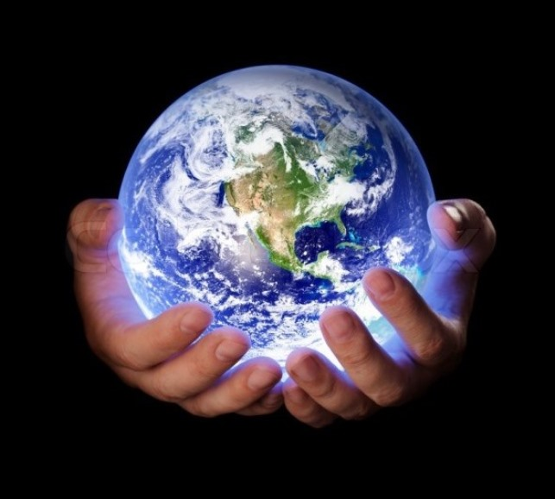
Our duty
We have to take care about the future generations and the future of the earth!

Slide 18
Thank you for your attention
Dr Athanasios Manouras
Technological Institute of Thessaly-Greece
Coordinator teacher
Karathanasi Stamatia
Assistant teacher
Mormori Androula
Students
Paulina Betsimea
Eleftheria Litou
Areti Triantafyllou

